Slide 1

COMPUTER HARDWARE

Slide 2
What is computer hardware ?
The computer is an amazingly useful general purpose technology, Computer hardware is the physical components that a computer system requires to function.
CPU
MOTHERBOARD
GRAPHICS CARD
WEBCAM
KEYBOARD

Slide 3

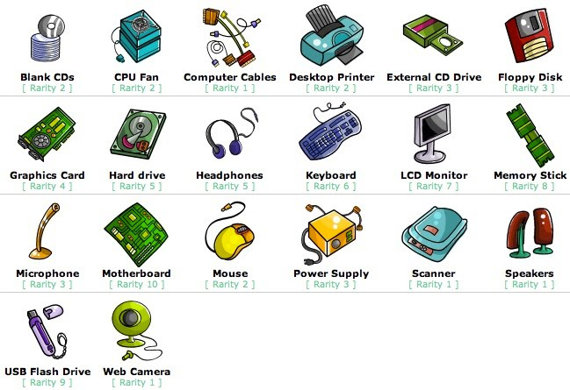
CPU:A central processing unit (CPU) is the electronic circuitry within a computer that carries out the instructions of a computer program by performing the basic arithmetic, logical, control input/output (I/O) operations specified by the instructions.
MOTHERBOARD: The motherboard serves as a single platform to connect all of the parts of computer together. It connects the CPU, memory, hard drives, optical drives, video card, sound card, and other ports and expansion cards directly or via cables.
GRAPHICS CARD: Graphics card is a hardware which is used to increase the video memory of a computer, and make its display quality more high-definition.
WEBCAM:A video camera that connected through internet.
KEYBOARD:A computer keyboard is a peripheral input device modeled after the typewriter keyboard which uses an arrangement of buttons or keys to act as mechanical levers or electronic switches

Slide 4

PSEUDOCODE
Start
Get two numbers
Add them
Print the answer
END
#include<stdio.h>
Int main()
{
Int num1,num2,sum;
Scanf(“%d,%d”,&num1,&num2);
Sum=num1+num2;
Printf(“sum”,%d);
Return 0;
}

Slide 5
FLOW CHART
START
ENTER NUM 1,NUM2
SUM =NUM1+NUM2
DISPLAY SUM
STOP

